Slide 1
U53: Coding Theory, Hamming Codes
K. Rajanikanth

Slide 2
Coding Theory
Data Communication: Transmit characters from some finite alphabet through a communication channel
Problem: All communication channels are noisy; non-zero probability of errors in transmission!
Similar Problem: When data is transferred from / to memory to /from disk
Coding Theory: How to improve the reliability of data transmission?
Detect / Correct transmission errors
Solution: Encode “message” at the transmitter end and decode it at receiver end.

Slide 3
Encode / Decode Messages
Encoding
Original Message
Coded Message
E
T
Channel
Decoding
Decoded Message
Received Message
D
Definition: An (m, n) code for a binary message consists of an encoding scheme E: B^{m} 🡪 B^{n} and a decoding scheme D: : B^{n} 🡪 B^{m} (m < n)
Note: B^{r} denotes the set of all binary strings of length r

Slide 4
Why Encode and then Decode!
The message to be transmitted is encoded in to a longer message
The “extra bits” help the Receiver detect and some times correct as well some transmission errors
How many extra bits? How many errors can be detected? How any can be corrected?
Extra bits to be transmitted 🡪 Increased cost / More erroneous bits?
Extra bits transmitted 🡪 Increased Detection / Correction capability
Compromise ; Engineering design decision!

Slide 5
Examples of Encoding and Decoding
Example 1: Even Parity
Add 1 extra bit to make the number 1s in the encoded message even.
Example: 0010 is encoded as 00101; 0011 is encoded as 00110
What are the error detection / correction capabilities?

Slide 6
Examples of Encoding and Decoding (2)
Example 2: Majority Vote
Append k copies of the message to the original message
Example: Message is 01; K = 2; Encoded message: 010101
Decoding Principle: For bit j, majority value of (k+1) bits in relevant positions
Assume received message is 010101
Decode: First bit: Majority of (0,0,0) = 0; Second bit: Majority of (1,1,1) = 1
Conclusion: No errors
Assume received message is 010100
Decode: First bit: Majority of (0,0,0) = 0; Second bit: Majority of (1,1,0) = 1
Conclusion: Last bit is in error!
Error detection / Correction capabilities?
What if k = 4 ? What if ......

Slide 7
Block Codes
Example 2 was an example of block code
Input binary sequence is split in to blocks of fixed size m (pad last block if required)
Each block of length m is encoded as a binary string of fixed length n,
n > m, and is transmitted;
it is called a codeword
Such Block Codes are quite popular for error detection / correction

Slide 8
A Group of Interest for Block Codes
Let B denote the set of all binary sequences of length n
Let ⊕ be a binary operation on B defined as follows:
For x and y in B, x ⊕ y is a bit string of length n that has
1 in every bit position where x and y differ and
0 in every bit position where x and y are same
Example: Let x = 0 1 1 0 0
and y = 1 0 1 0 1
Then x⊕y = 1 1 0 0 1

Slide 9
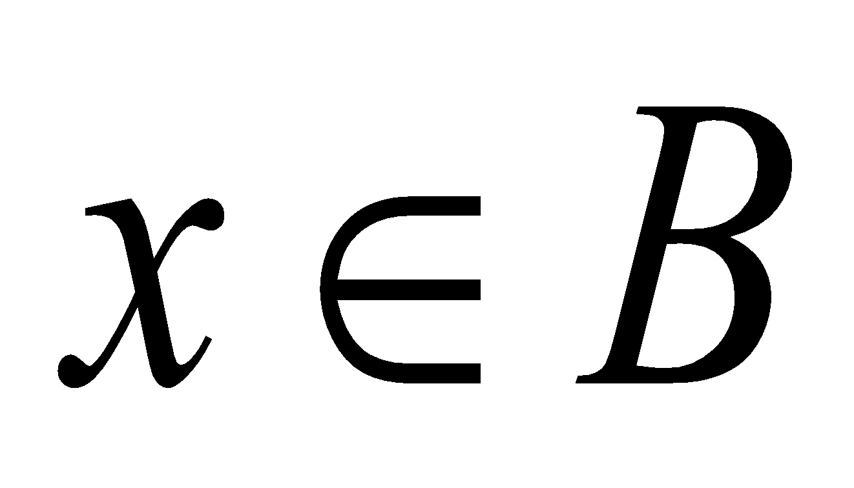
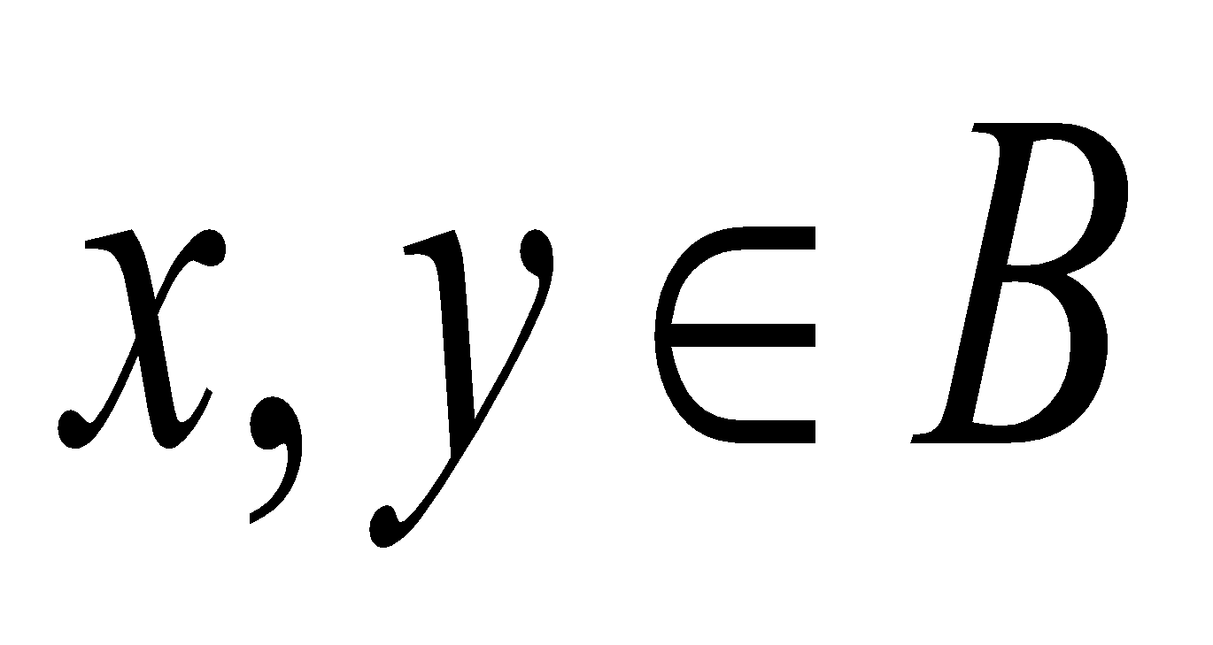
Weight Function
(B, ⊕) is a group (Prove it!)
A string of n zeros is the identity
For every x in B, x itself is the inverse of x
Motivation for introducing this group? Motivation for Weight function?
Let The weight of x denoted as w(x) is the number of 1’s in x.
Example: x = 0 1 1 0 0 w(x) = 2
Let Define distance between x and y as d(x, y) = w (x⊕y)
( d is also called Hamming Distance in honour of Richard Hamming who did pioneering work in Coding Theory)

Slide 10
Transmission Errors
If x is the transmitted word and y is the received word, then the number of
bits which were transmitted erroneously is w (x⊕y)
Example: Transmitted word x = 0 1 1 0 0
Received word y = 1 1 1 0 1
d(x, y) = w (x⊕y) = w (1 0 0 0 1) = 2
Number of bits which were transmitted erroneously = 2

Slide 11
Properties of Distance Function
d (x, y) = d (y, x)
d(x, y) ≥ 0
d (x, y) = 0 iff x = y
d (x, y) ≤ d(x, z) + d (z, y) (Proof?)
Hint: w (x⊕y) ≤ w (x) + w (y)

Slide 12
Minimum Distance, Error Correction
Let G be a block code. codewords are of length n. G = {x₁ , x₂ , x₃ , ... , x_{N} }
distance of G = minimum distance between any pair of distinct code words in G
Let y be the received word. What could be the transmitted word x?
Maximum Likelihood Decoding Criterion:
Let P (x_{j} / y) = Probability that x_{j} is the transmitted word given that
y is the received word (How to compute this!)
x_{k} is the transmitted word if P (x_{k} / y) is the largest among
P (x_{j} / y) , j = 1 to N

Slide 13
Minimum Distance, Error Correction (2)
P (x_{j} / y) = ?
Assume that errors in positions are independent and are equi-probable
Probability of error in a single position = p
Let d (x_{j ,} y) = t
Then P (x_{j} / y) = p^{t} (1 – p)^{(n-t)}
For p ‹ 0.5, smaller d (x_{j ,} y) leads to larger P (x_{j} / y) (Prove!)
Thus we decode x_{k} is the transmitted word if d (x_{k} , y) is the smallest among d (x_{j} , y) , j = 1 to N
Maximum Likelihood Decoding = Minimum Distance Decoding!

Slide 14
Minimum Distance, Error Correction (3)
Let M be minimum distance of a block code
Let C be the number of errors we want the code to correct
Let D be the number of errors we want the code to detect
Obviously, C <= D
Then M = C + D + 1
Example:
M = 4
We can detect up to 3 errors and correct none OR
Detect up to 2 errors and correct up to 1 error (how?)

Slide 15
Minimum Distance, Error Correction (4)
A code of distance 2t + 1 can correct t or fewer errors when minimum
distance decoding criterion is used
Proof:
Transmitted codeword: x; Received word: y; By assumption, d(x, y) <= t
Let x’ be another codeword
d (x, x’) >= 2t + 1;
d (x, x’) <= d (x, y) + d (y, x’) 🡪 d (y, x’) >= t + 1
X is selected as the codeword transmitted!
What if the minimum distance is only 2t ?

Slide 16
Group Codes
Let B be the set of all binary sequences of length n
We saw that (B, ⊕) is a group
G, a subset of B, is called a group code if (G, ⊕ ) is a subgroup of (B, ⊕ )
Example:
Consider the group (B⁴ , ⊕ )
Let G = {0000, 0011, 1101, 1110}
(G , ⊕ ) is a subgroup of (B⁴, ⊕ ) // Prove
G is a group code
(where from we got G!)

Slide 17
Hamming Codes (Group Codes)
Single-error correcting codes
Highly efficient encoding and decoding
Can locate the position of the single error and thus correct it
distance of code = (d=1) + (c =1) + 1 = 3
Best use of additional bits (n – m bits)
For any r:
m = 2^{r} – 1 – r ; n = 2^{r} – 1; r bits as parity encoders!
r is selected based on the desired message length m
This gives the value of n and there by the number of parity bits

Slide 18
Hamming Codes (2)
m = 2^{r} – 1 – r ; n = 2^{r} – 1; r bits as parity encoders!
Depending on where we place the parity bits, the encoding matrix is formed as seen earlier for generating group codes
One popular approach: The r parity bits are located in positions 1, 2, 4, ..., 2^{r-1}
Example:
Let r = 3 ; m = 4; n = 7
parity bits are in positions 1, 2, and 4
Message bits in the remaining 4 positions
Thus, if message is a= a1, a2, a3, a4 then code word is b = b1, b2, b3, b4, b5, b6, b7 where b1, b2, b4 are parity check bits and b3 =a1; b5=a2; b6=a3; and b7=a4

Slide 19
Hamming Codes (3)
Example (continued):
Message a is 1 x 4 row vector
Encoding Boolean matrix is e is 4 x 7 matrix
Codeword b is 1 x 7 row vector; b = a * e
e is formed as follows:
Columns other than 1, 2, and 4 (parity columns) form identity matrix
Parity columns are any distinct, non-zero columns!

Slide 20
Hamming Codes (4)
Example (continued):
Thus e can be:
1 1 1 0 0 0 0
1 0 0 1 1 0 0
0 1 0 1 0 1 0
1 1 0 1 0 0 1
If message is a1 a2 a3 a4 then codeword b1 b2 b3 b4 b5 b6 b7 is given by a * e .
Thus
b1 = a1 + a2 + a4 b2 = a1 + a3 + a4
b3 = a1 b4 = a2 + a3 + a4
b5 = a2 b6 = a3
b7 = a4

Slide 21
Hamming Codes - Encoding
Example (continued):
(Even) Parity Equations:
b1 = a1 + a2 + a4 🡪 b1 + a1 + a2 + a4 = 0
b2 = a1 + a3 + a4 🡪 b2 + a1 + a3 + a4 = 0
b4 = a2 + a3 + a4 🡪 b4 + a2 + a3 + a4 = 0
b1, b2, and b4 are chosen such that the above parity equations are satisfied
This is the encoding

Slide 22
Hamming Codes - Decoding
Example (continued):
b1 b2 a1 b4 a2 a3 a4 is the transmitted word; it will be the received word also if there are no transmission errors; then parity equations will hold.
b4 + a2 + a3 + a4 = 0
b2 + a1 + a3 + a4 = 0
b1 + a1 + a2 + a4 = 0
Write this as b * H where b is 1 x 7 received word and H is 7 x 3 parity check matrix

Slide 23
Hamming Codes - Decoding (2)
Example (continued):
H = 0 0 1
0 1 0
0 1 1
1 0 0
1 0 1
1 1 0
1 1 1
If there are no transmission errors, b * H = 0
Assume that there is exactly one bit error, say in a1
Then received word can be written as b ⊕ e where e is the error row vector: 0 0 1 0 0 0 0
We compute (b ⊕ e) * H = b * H ⊕ e * H = 0 ⊕ e * H
e * H = 0 1 1 🡪 Not 0 0 0 ; so error
Further, 011 indicates the position (in binary) where error occurred!
It can be now corrected!!

Slide 24
Hamming Codes - Decoding (3)
Example (continued):
H = 0 0 1
0 1 0
0 1 1
1 0 0
1 0 1
1 1 0
1 1 1
This is bit position in
binary!!
Assume message is 1010
After encoding it becomes 1 0 1 1 0 1 0 (check!)
Assume error in first bit; so the received word r is:
0 0 1 1 0 1 0
r * H = 0 0 1 🡪 Not 0 0 0 ; so error
Further, 0 0 1 indicates the position (in binary) where error occurred!
It can be now corrected!!
Note that this is not message bit but parity bit!

Slide 25
Hamming Codes - Decoding (4)
The above example can be generalized easily
If errors occur in two bit positions, this scheme will fail (why?)
Again, assume message is 1010
After encoding it becomes 1 0 1 1 0 1 0
Assume errors in first bit and last bit; so the received word r is:
0 0 1 1 0 1 1
r * H = 1 1 0 🡪 Error, but the position indicated is 6; after correcting the bit in that position, the decoder decides the transmitted word is 0 0 1 1 0 0 1 !
We can add another parity bit to the codeword to make it single-error correcting and double-error detecting code!

Slide 26
Thank You

